Slide 1

21AIE205 Python for Machine Learning Capstone Project Stock Price Prediction
Team -10
CH.EN.U4AIE21014 – G Chaithanya
CH.EN.U4AIE21016 – Y Hemanth
CH.EN.U4AIE21024 – K Koushik
CH.EN.U4AIE21034 – P Haneef
CH.EN.U4AIE21046 – S Pranav Reddy

Slide 2
Index
OVERVIEW
INTRODUCTION
OBJECTIVES
EXISTING WORS
RESEARCH GAP
PROPOSED ALGORITHM
PROPOSED ARCHITECTURE
PREDICTION TECHNIQUE
IMPLEMENTATION DETAILS
RESULT
CONCLUSION

Slide 3
Overview
Our project is to predict the stock graph which is going to be happened in the future.
So we are using machine learning algorithm called LSTM (long short term memory).
Because at several experts consider LSTM as the most promising stock prediction algorithm. It’s basically a type of RNN, but unlike standard RNNs, can process both single data points and more complex data sequences.
We are doing this project to decrease the loss percentage of money when they are investing it uses as a referal.

Slide 4
Introduction
A correct prediction of stocks can lead to huge profits to the seller and the broker.
Frequently, it is brought out that prediction is confusing rather than random, which means it can be predicted by carefully analyzing the history of respective stock market.
So that Machine learning is an efficient way to represent such processes. It predicts a market value close to the tangible value, thereby it will increase the accuracy.
Introduction of machine learning to the area of stock prediction had brought to many researches because of its efficient and accurate measurements.
At the same time, these models don’t need to reach high level of accuracy because even 70% accuracy can deliver solid returns.

Slide 5
Aim:- To predict the stock using LSTM
Objectives:-
To predict the graph of the stock
To attain the predicted graph and the values of the stock and comparing them with the expected values.
To compare our model’s accuracy with different types of models with the same data set.
To implement the LSTM to predict the graph
Get the accuracy above 60%

Slide 6
Existing Works
The techniques used for prediction include four different version of Artificial Neural Network (ANN)
Single Layer Perceptron (SLP)
Multi-layer Perceptron (MLP)
Radial Basis Function (RBF)
Deep Belief Network (DBN)
Other techniques include
SVM(Support Vector Machine), Decision Tree and Naïve Bayes.

Slide 7
Research Gap
We have gone through some of the major existing works till now that we are using like ANN, SVM, Decision Tree etc.. But we have seen many disadvantages that we can solve using RNN technique called LSTM. So that we have taken LSTM now I will explain some of the disadvantages present in existing works.
Neural networks do not make any forecasts (ANN), so they will analyze price data and uncover opportunities.
SVM :- it does not execute very well when the data set has more sound ex:- target classes are overlapping.
Decision Tree:- One of the limitations of decision trees is that they are largely unstable compared to other decision predictors.
So that we are using LSTM to solve the all the above problems

Slide 8



Proposed Algorithm
Input Data of the stock
Fetch the Data
Plot the Data points
LSTM
Train the Model
Using (LSTM)
Save Model
Plot Predicted Results
Predict Stock for n days

Slide 9
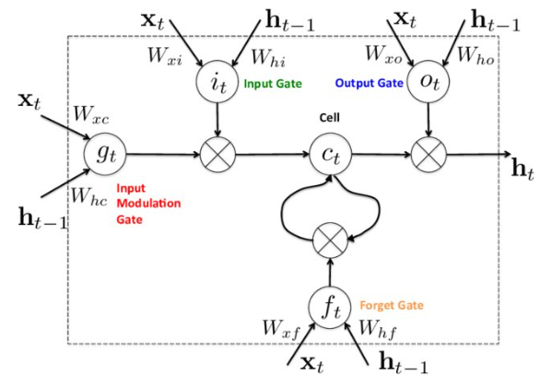
Proposed Architecture

Slide 10
Steps in LSTM
Import the Libraries.
Load the Training Dataset.
Use the Open Stock Price Column to Train Your Model.
Creating X_train and y_train Data Structures.
Normalizing the Dataset.
Reshape the Data.
Building the Model by Importing the Crucial Libraries and Adding Different Layers to LSTM.
Fitting the Model.
Extracting the Actual Stock Prices of Jan-2022.
Preparing the Input for the Model.
Predicting the Values for Jan 2022 Stock Prices.

Slide 11
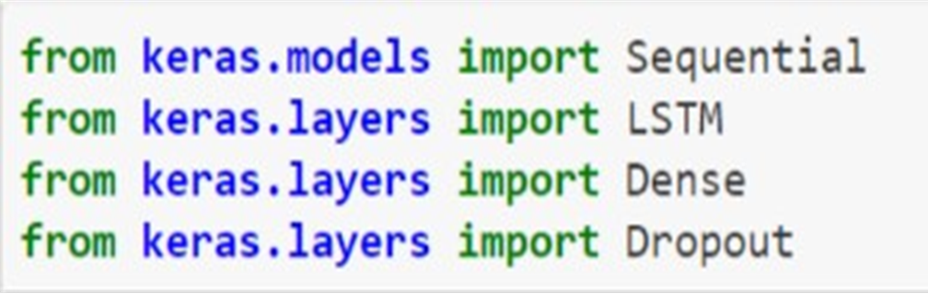
Used Libraries

Slide 12
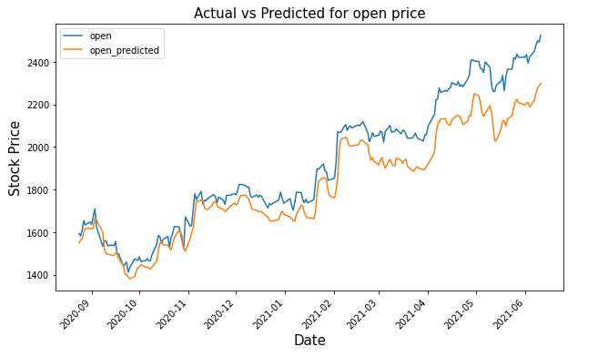

Slide 13
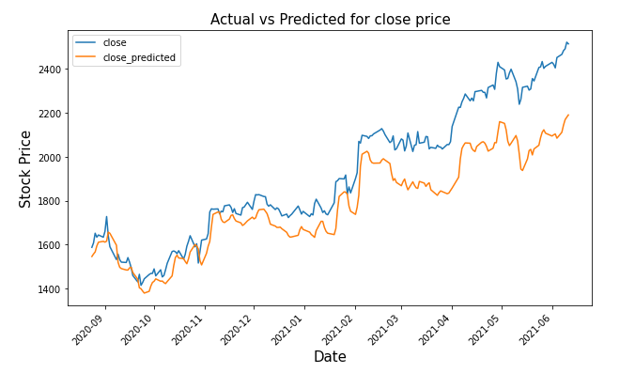

Slide 14
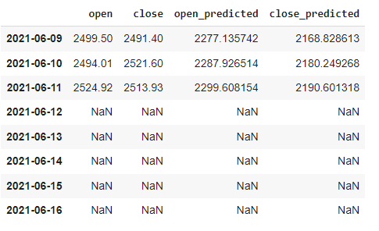
Output

Slide 15
Conclusion
Use of recently introduced machine learning techniques in the prediction of stocks have yielded promising results and thereby marked the use of them in profitable exchange schemes.
So, by this we can conclude that it is possible to predict stock market with more accuracy and efficiency using machine learning techniques.
In the future, the stock market prediction system can be further improved by utilizing a much bigger dataset.
Now we are getting more that 63% accuracy by this we can get the solid profits.

Slide 16
Thank You

